Slide 1
Python Session 4 – ClAsses continued

Slide 2
Exercise 1
Define a math class which perform following function
Max from a list
Min from a list
Top 3 from the list
Cube
Calculate area of circle with radius as an argument

Slide 3
Static methods
A static method does not receive an implicit first argument. To declare a static method, use this idiom:
It can be called either on the class (such as C.f()) or on an instance (such as C().f()). The instance is ignored except for its class.
The @staticmethod form is a function decorator – see the description of function definitions inFunction definitions for details.
class MyClass(object):
@staticmethod
def the_static_method(x):
print x
MyClass.the_static_method(2) # outputs 2

Slide 4
Accessing unknown members
Problem: Occasionally the name of an attribute or method of a class is only given at run time…
Solution:
getattr(object_instance, string)
string is a string which contains the name of an attribute or method of a class
getattr(object_instance, string) returns a reference to that attribute or method
f = student(“Bob Smith”, 23)
>>> getattr(f, “full_name”)
“Bob Smith”
>>> getattr(f, “get_age”)
<method get_age of class studentClass at 010B3C2>
>>> getattr(f, “get_age”)() # call it
23
>>> getattr(f, “get_birthday”)
# Raises AttributeError – No method!

Slide 5
Accessing unknown members
hasattr(object_instance, string)
f = student(“Bob Smith”, 23)
>>> hasattr(f, “full_name”)
True
>>> hasattr(f, “get_age”)
True
>>> hasattr(f, “get_birthday”)
False

Slide 6
Two Kinds of Attributes
The non-method data stored by objects are called attributes
Data attributes
Variable owned by a particular instance of a class
Each instance has its own value for it
These are the most common kind of attribute
Class attributes
Owned by the class as a whole
All class instances share the same value for it
Called “static” variables in some languages
Good for (1) class-wide constants and (2) building counter of how many instances of the class have been made

Slide 7
Data Attributes
Data attributes are created and initialized by an __init__() method.
Simply assigning to a name creates the attribute
Inside the class, refer to data attributes using self
for example, self.full_name
class teacher: “A class representing teachers.” def __init__(self,n): self.full_name = n def print_name(self): print self.full_name

Slide 8
Class Attributes
Because all instances of a class share one copy of a class attribute, when any instance changes it, the value is changed for all instances
Class attributes are defined within a class definition and outside of any method
Since there is one of these attributes per class and not one per instance, they’re accessed via a different notation:
Access class attributes using self.__class__.name notation -- This is just one way to do this & the safest in general.
class sample: >>> a = sample() x = 23 >>> a.increment() def increment(self): >>> a.__class__.x self.__class__.x += 1 24

Slide 9
Data vs. Class Attributes
class counter: overall_total = 0 # class attribute def __init__(self): self.my_total = 0 # data attribute def increment(self): counter.overall_total = \ counter.overall_total + 1 self.my_total = \ self.my_total + 1
>>> a = counter() >>> b = counter() >>> a.increment() >>> b.increment() >>> b.increment() >>> a.my_total 1 >>> a.__class__.overall_total 3 >>> b.my_total 2 >>> b.__class__.overall_total 3

Slide 10
Public and Private Data
Currently everything in atom/molecule is public, thus we could do something really stupid like
>>> at = atom(6,0.,0.,0.)
>>> at.position = 'Grape Jelly'
that would break any function that used at.position
Encapsulation is particularly important when other people use your class
In Python anything with two leading underscores is private
__a, __my_variable
Anything with one leading underscore is semi-private, and you should feel guilty accessing this data directly.
_b
Sometimes useful as an intermediate step to making data private
Note: There is no ‘protected’ status in Python; so, subclasses would be unable to access these private data either.

Slide 11
Why Encapsulate?
By defining a specific interface you can keep other modules from doing anything incorrect to your data
By limiting the functions you are going to support, you leave yourself free to change the internal data without messing up your users
Write to the Interface, not the the Implementation
Makes code more modular, since you can change large parts of your classes without affecting other parts of the program, so long as they only use your public functions

Slide 12
Built-In Members of Classes
Classes contain many methods and attributes that are included by Python even if you don’t define them explicitly.
Most of these methods define automatic functionality triggered by special operators or usage of that class.
The built-in attributes define information that must be stored for all classes.
All built-in members have double underscores around their names: __init__ __doc__
For example, the method __repr__ exists for all classes, and you can always redefine it
The definition of this method specifies how to turn an instance of the class into a string
print f sometimes calls f.__repr__() to produce a string for object f
If you type f at the prompt and hit ENTER, then you are also calling __repr__ to determine what to display to the user as output

Slide 13
Special Methods – Example
class student: ... def __repr__(self): return “I’m named ” + self.full_name ...
>>> f = student(“Bob Smith”, 23)
>>> print f
I’m named Bob Smith
>>> f
“I’m named Bob Smith”

Slide 14
Special Methods
You can redefine these as well:
__init__ : The constructor for the class
__eq__ : Define how == works for class
__len__ : Define how len( obj ) works
__copy__ : Define how to copy a class
Other built-in methods allow you to give a class the ability to use [ ] notation like an array or ( ) notation like a function call

Slide 15
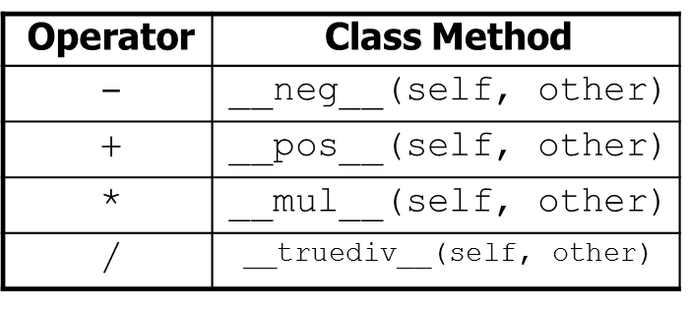
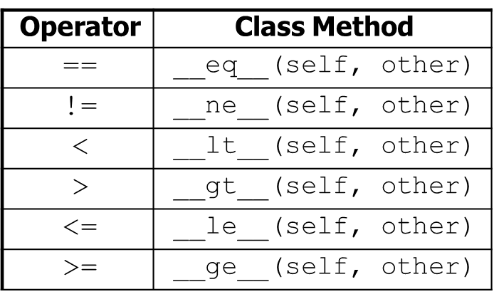
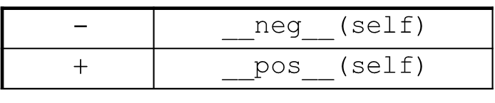
Operator Overloading
operator overloading: You can define functions so that Python's built-in operators can be used with your class.
See also: http://docs.python.org/ref/customization.html

Slide 16
Classes that look like arrays
Overload __getitem__(self,index) to make a class act like an array
class molecule:
def __getitem__(self,index):
return self.atomlist[index]
>>> mol = molecule('Water') #defined as before
>>> for atom in mol: #use like a list!
print atom
>>> mol[0].translate(1.,1.,1.)
Previous lectures defined molecules to be arrays of atoms.
This allows us to use the same routines, but using the molecule class instead of the old arrays.
An example of focusing on the interface!

Slide 17
Classes that look like functions
Overload __call__(self,arg) to make a class behave like a function
class gaussian:
def __init__(self,exponent):
self.exponent = exponent
def __call__(self,arg):
return math.exp(-self.exponent*arg*arg)
>>> func = gaussian(1.)
>>> func(3.)
0.0001234

Slide 18
Other things to overload
__setitem__(self,index,value)
Another function for making a class look like an array/dictionary
a[index] = value
__add__(self, other)
Overload the "+" operator
molecule = molecule + atom
__mul__(self,number)
Overload the "*" operator
zeros = 3*[0]
__getattr__(self,name)
Overload attribute calls
We could have done atom.symbol() this way
__del__(self)
Overload the default destructor
del temp_atom
__len__(self)
Overload the len() command
natoms = len(mol)
__getslice__(self,low,high)
Overload slicing
glycine = protein[0:9]
_cmp__(self,other):
On comparisons (<, ==, etc.) returns -1, 0, or 1, like C's strcmp

Slide 19
Mapping Operators to Functions
Operation | Syntax | Function
Addition | a + b | add(a, b)
Concatenation | seq1 + seq2 | concat(seq1, seq2)
Containment Test | obj in seq | contains(seq, obj)
Division | a / b | div(a, b) (without __future__.division)
Division | a / b | truediv(a, b) (with__future__.division)
Division | a // b | floordiv(a, b)
Bitwise And | a & b | and_(a, b)
Bitwise Exclusive Or | a ^ b | xor(a, b)
Bitwise Inversion | ~ a | invert(a)
Bitwise Or | a | b | or_(a, b)
Exponentiation | a ** b | pow(a, b)
Identity | a is b | is_(a, b)
Identity | a is not b | is_not(a, b)
Indexed Assignment | obj[k] = v | setitem(obj, k, v)
Indexed Deletion | del obj[k] | delitem(obj, k)
Indexing | obj[k] | getitem(obj, k)
Left Shift | a << b | lshift(a, b)
Modulo | a % b | mod(a, b)
Multiplication | a * b | mul(a, b)
Negation (Arithmetic) | - a | neg(a)
Negation (Logical) | not a | not_(a)
Positive | + a | pos(a)
Right Shift | a >> b | rshift(a, b)
Sequence Repetition | seq * i | repeat(seq, i)
Slice Assignment | seq[i:j] = values | setitem(seq, slice(i, j), values)
Slice Deletion | del seq[i:j] | delitem(seq, slice(i, j))
Slicing | seq[i:j] | getitem(seq, slice(i, j))
String Formatting | s % obj | mod(s, obj)
Subtraction | a - b | sub(a, b)
Truth Test | obj | truth(obj)
Ordering | a < b | lt(a, b)
Ordering | a <= b | le(a, b)
Equality | a == b | eq(a, b)
Difference | a != b | ne(a, b)
Ordering | a >= b | ge(a, b)
Ordering | a > b | gt(a, b)

Slide 20
Exercise
Exercise: Write a Fraction class to represent rational numbers like 1/2 and -3/8.
Fractions should always be stored in reduced form; for example, store 4/12 as 1/3 and 6/-9 as -2/3.
Hint: A GCD (greatest common divisor) function may help.
Define add and multiply methods that accept another Fraction as a parameter and modify the existing Fraction by adding/multiplying it by that parameter.
Define +, *, ==, and < operators.

